Slide 1
City Navigation and Emergency Route Planning Tool
Group5 :
Rohit Bhaskar Uday : Algorithm Expert Viditi Vartak : Visualization And Maps Tushar Yadav : Simulation of Blockages and Project Manager
Rohit Chowdary Yadla: QA and Testing Huan Ying : Data Collection Shiyun Zhou : Data Collection

Slide 2
Table of Content
STEP 4
STEP 1
Introduction
Simulation of Blockages
STEP 2
STEP 5
Data Collection
User Interface
STEP 6
STEP 3
Implementation
Testing & Results

Slide 3
Introduction
City Navigation and Emergency Route Planning Tool is a city navigation tool capable of calculating the shortest path from A spot to B spot based on the weight of the road in Orange County, California.

Slide 4
Implementation 1

Slide 5
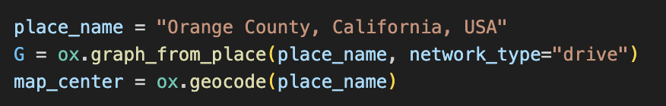
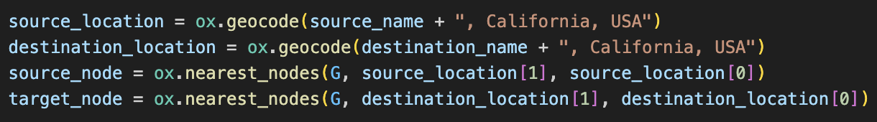
Data Collection
Data Acquisition
OSMnx Library & OpenStreetMap API
Road Selection
network_type=”drive”
Data Geocoding
ox.geocode
Node Identification
Nearest_nodes

Slide 6
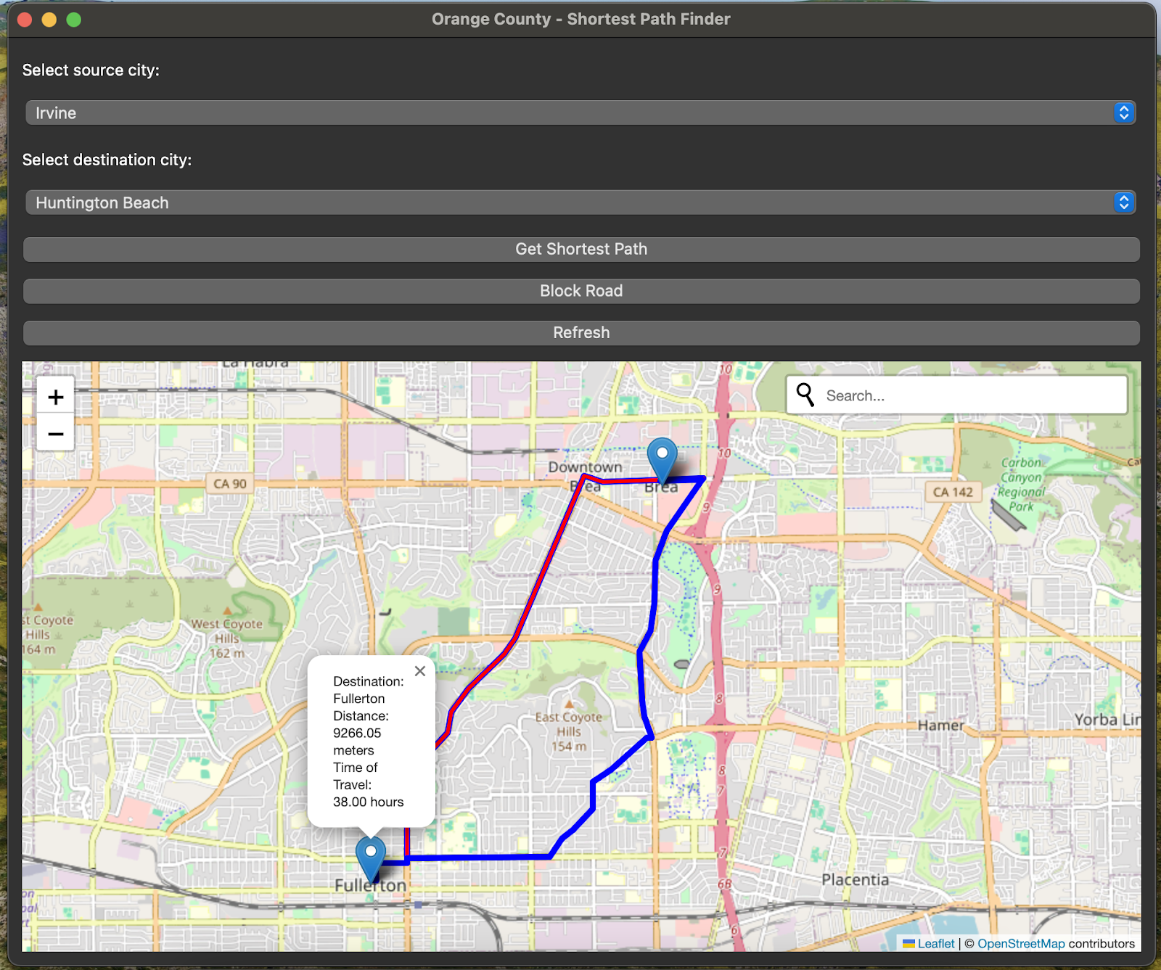
User Interface
A user-friendly interface, combining PyQt5 and Folium for an intuitive experience for route planning within Orange County, California.
Users can easily select source and destination cities from a predefined list of 35 cities in California.
Users can visualize calculated paths, blocked roads, and alternative routes in real-time.

Slide 7
Implementation
Data Acquisition and Processing: We utilized the OSMnx library to retrieve detailed road network data from OpenStreetMap (OSM) for California cities.
Graph Creation and Manipulation: Using NetworkX, we constructed a graph representation of the road network. Each node represents an intersection or point of interest, while edges represent road segments connecting nodes.
Shortest Path Calculation: For finding the shortest path between two cities, we applied Dijkstra's algorithm, which efficiently explores the graph to find the path with the minimum total distance.
*Additionally, we tried implemented the Floyd-Warshall algorithm to handle road blockages, allowing the system to dynamically find alternate routes when certain roads are unavailable.

Slide 8
Simulation of Blockages
Dynamic Road Blockage Handling: To simulate road blockages, we introduced a feature that allows us to block specific road segments dynamically. When a road segment is blocked, we increase the weight of the corresponding edge in the graph representation. This change in weight effectively prevents the algorithm from considering that road segment when calculating the shortest path.
Alternate Route Calculation: Upon blocking a road segment, the algorithm automatically recalculates the shortest path between the source and destination nodes. By penalizing the blocked road segment with a higher weight, the algorithm finds an alternate route that avoids the blocked segment. This dynamic adaptation ensures that users can still find efficient routes even when faced with road closures or blockages.

Slide 9
Implementation 2

Slide 10
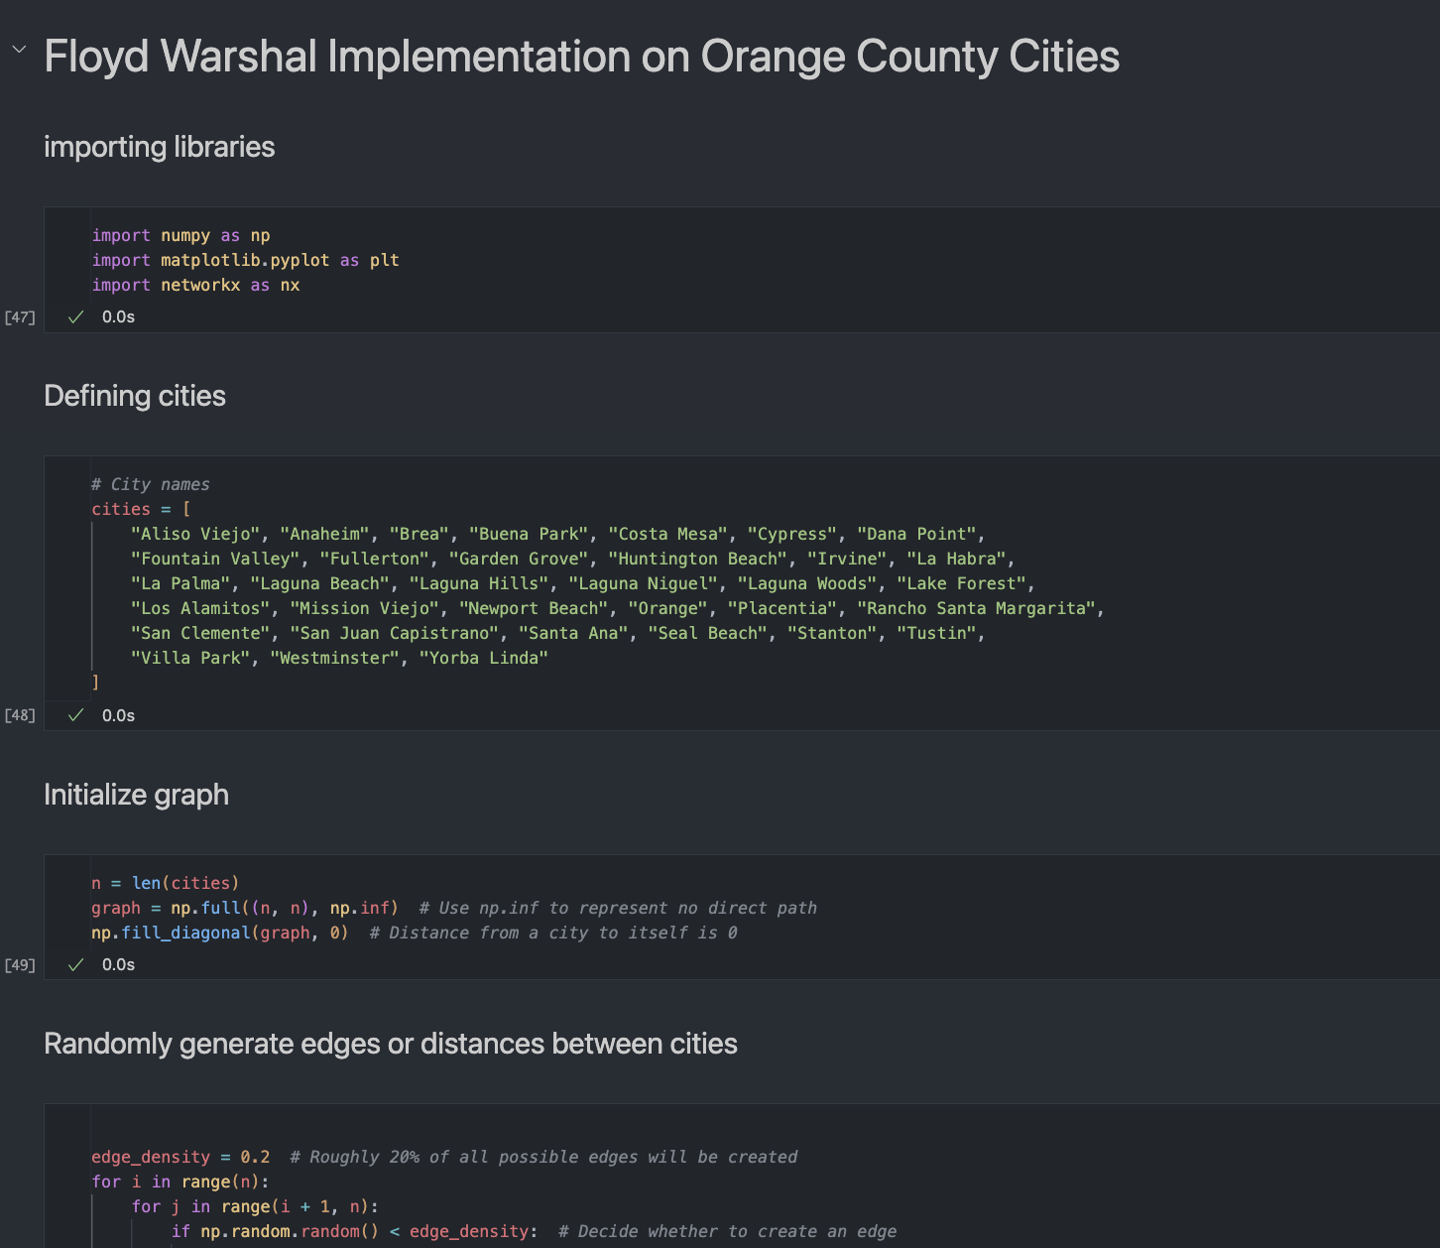
Implementation Overview
Brief overview of using the Floyd-Warshall algorithm to model a network of cities connected by roads of varying distances.
Objective: To demonstrate the algorithm's utility in determining the shortest paths between all pairs of nodes for efficient route planning and infrastructure development.
Floyd-Warshall Algorithm: A dynamic programming solution for finding shortest paths in a weighted graph with positive or negative edge weights (but without negative cycles).
Computational Complexity: O(n3)

Slide 11
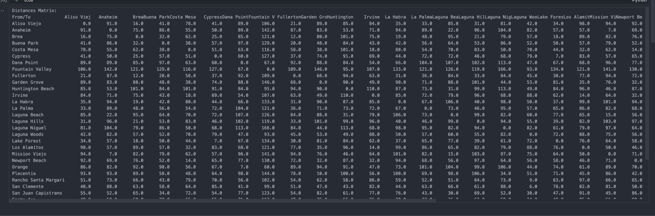
Implementation Overview
Distance Matrix generated using Floyd Warshall Algorithm

Slide 12
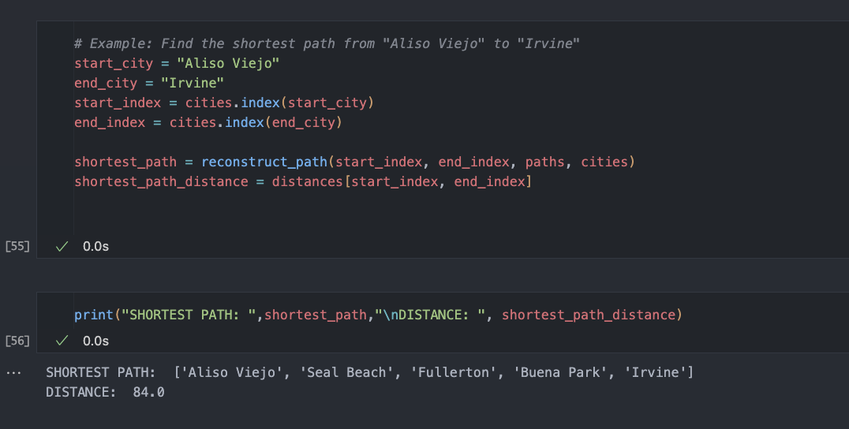
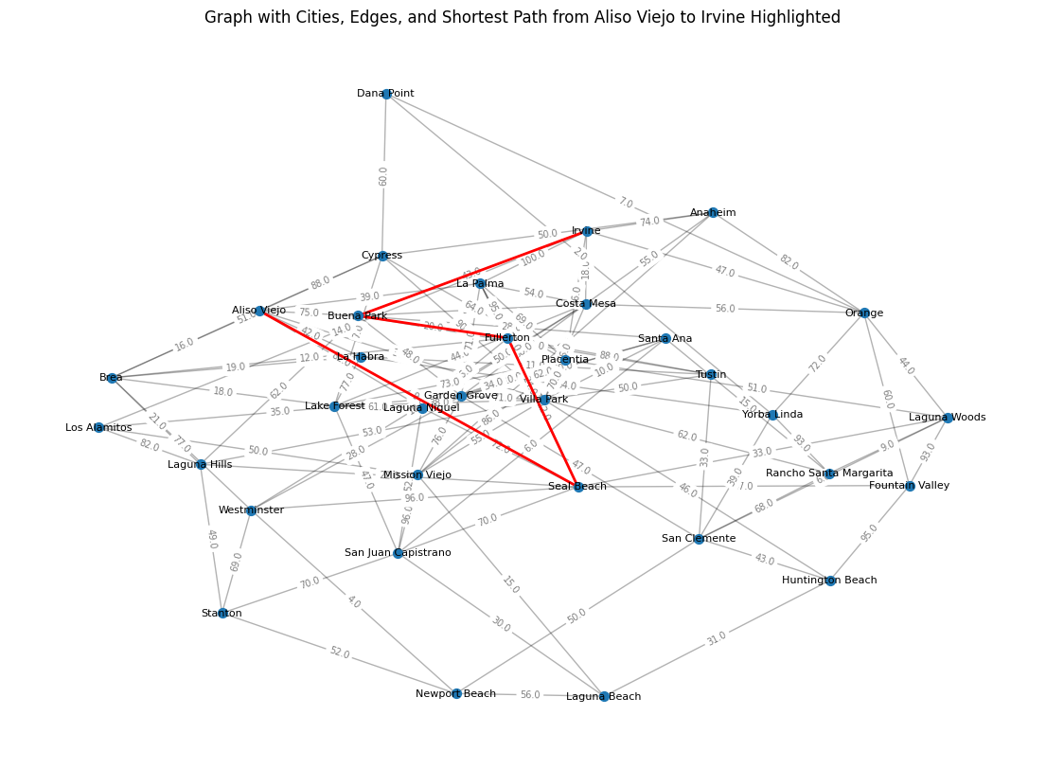

Slide 13
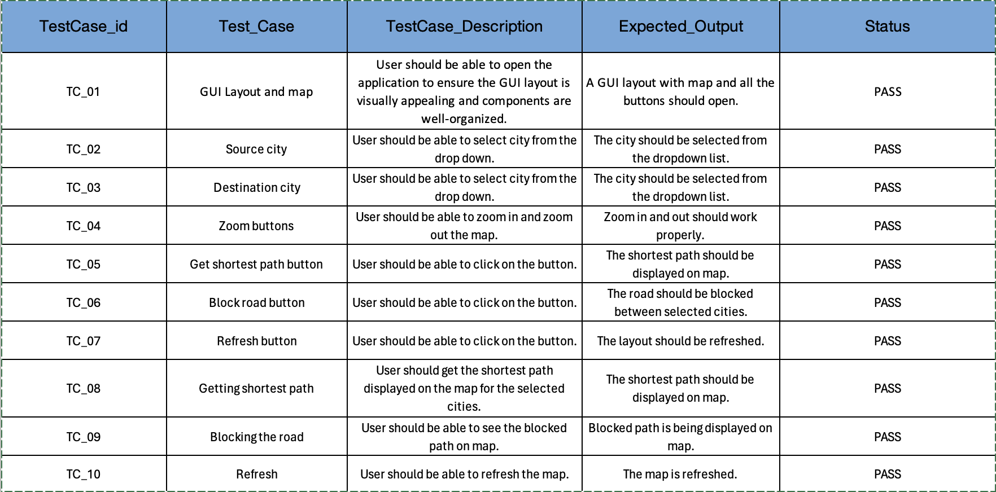
Testing

Slide 14
Challenges Faced
Memory Constraints
Issue: Handling large datasets (61GB in MacOS, 42GiB in Windows) led to memory allocation errors.
Details: Matrix operations couldn't be performed due to memory limitations, hindering data processing.
Threading Issues
Issue: Overlapping threads causing termination.
Details: Concurrent execution led to conflicts and premature termination of threads, impacting the application's stability.
Performance Bottlenecks with Spatial Matrix
Issue: Application freezing or becoming unresponsive during prolonged computations.
Details: Implementing spatial matrices resulted in extended processing times, causing the application to stall while awaiting output.

Slide 15
References
1. Boeing, Geoff. “OSMnx.” GitHub, 28 Mar. 2022, github.com/gboeing/osmnx.
2. Hagberg, Aric, et al. "NetworkX: High Productivity Software for Complex Networks." GitHub Repository. github.com/networkx/networkx
3. Python Visualization. "Folium Documentation." Folium Documentation. github.com/python-visualization/folium
4. The Qt Company Ltd. "PyQt5 Documentation." PyQt5 Documentation. doc.qt.io/qtforpython/
5. The Qt Company Ltd. "QWebEngineView Class." Qt Documentation. doc.qt.io/qt-5/qwebengineview.html

